Slide 1
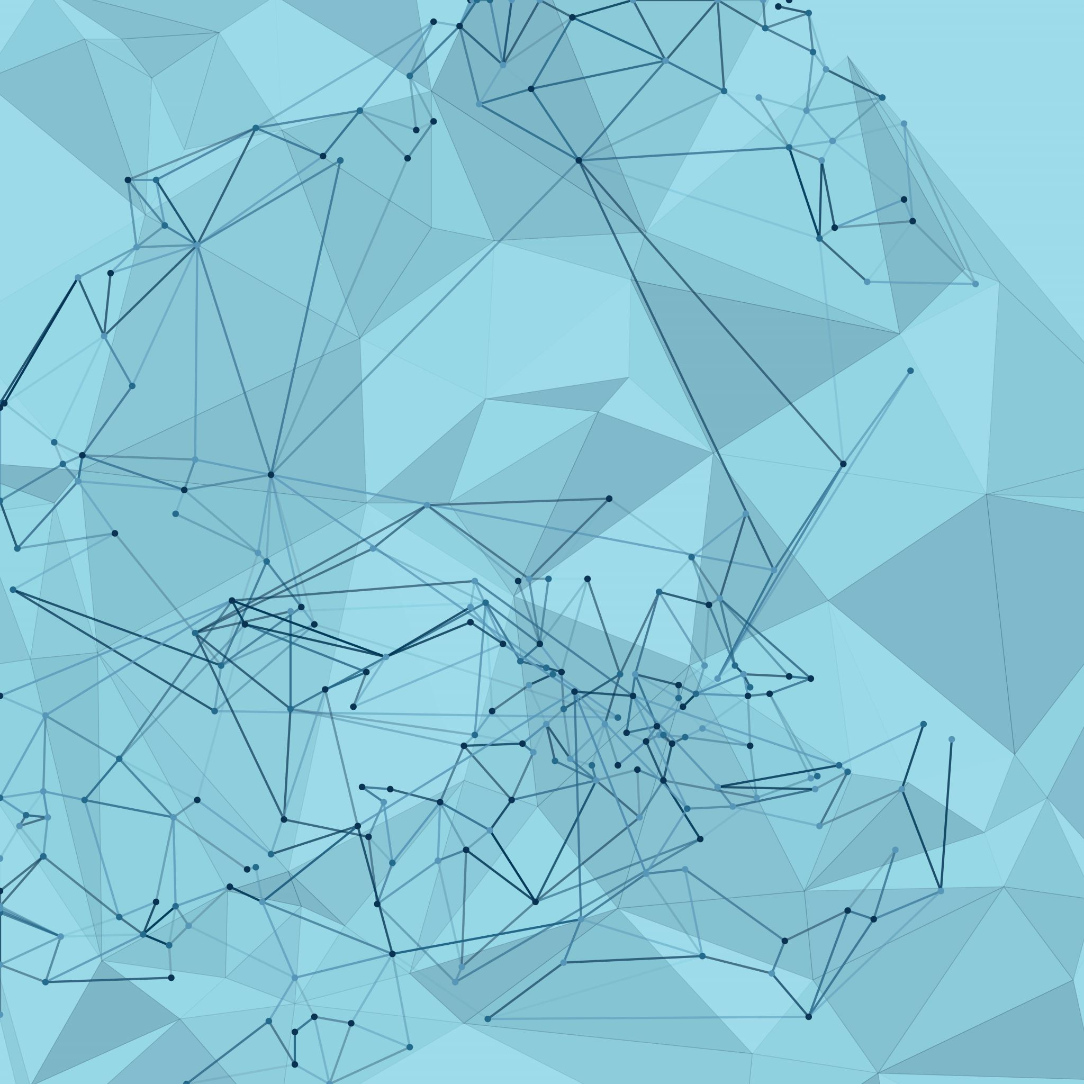
Using AI and Machine Learning for Time Series medical signal analysis
Aiden Rushbrooke
Aiden.Rushbrooke@uea.ac.uk

Slide 2
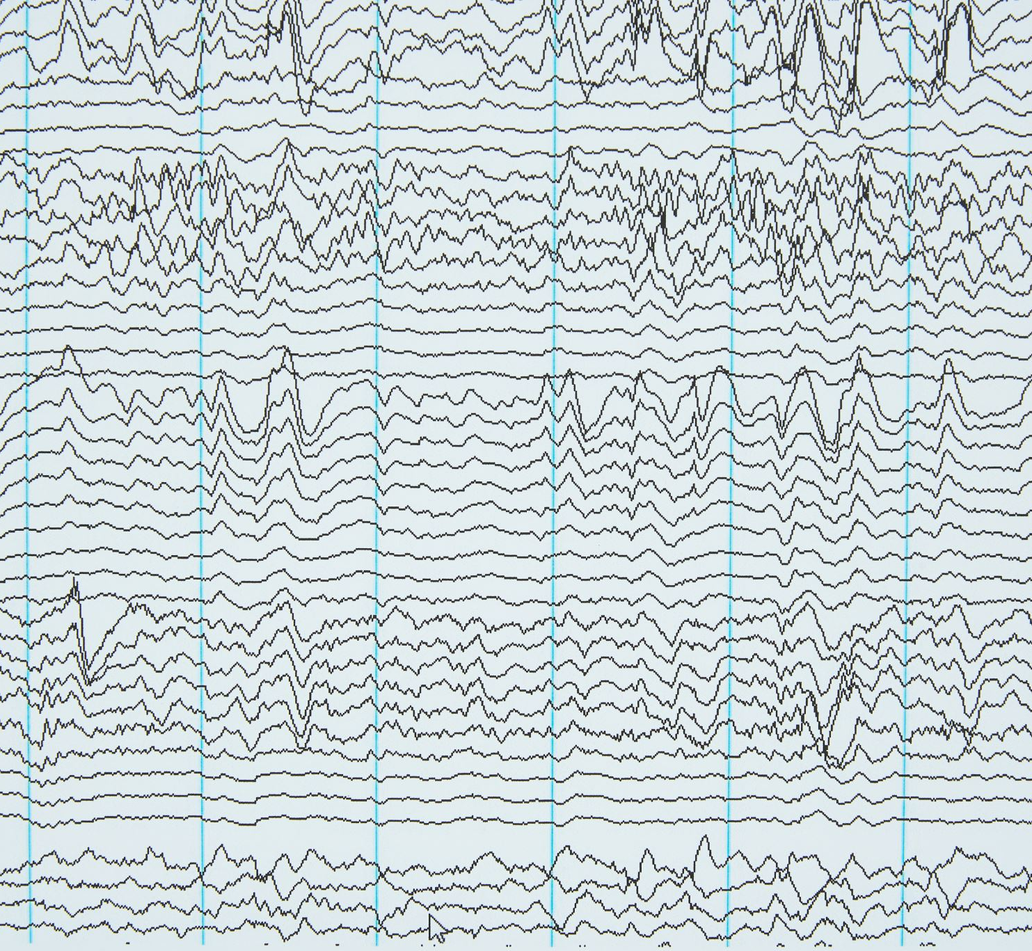
Time Series
Data recorded over time
Evenly spaced time points
One series (univariate) or multiple (multivariate) per recording
Examples
Earthquake monitoring
Financial records
GPS trackers
Medical Signals (EEG, heart rate, blood pressure)

Slide 3
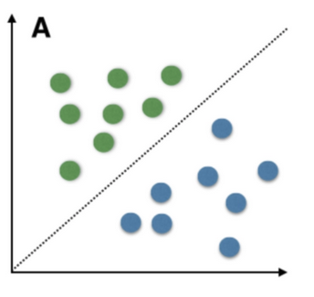
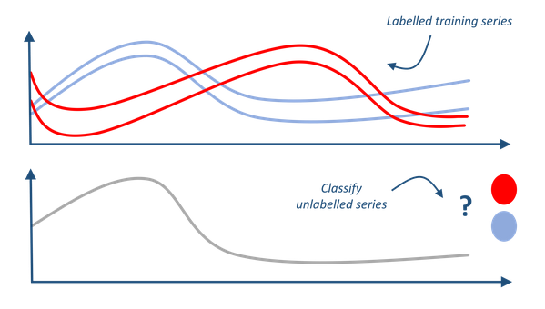
Classification
Assign labels, or classes, to data
Learn from known data
Predict for unknown data
Compare to true values to evaluate performance
Look for discriminatory features between the classes
Most commonly binary (2 classes) but can be more
Used for detection of disorders and conditions
Epileptic seizure detection
Arrythmia
Sleep Disorders

Slide 4
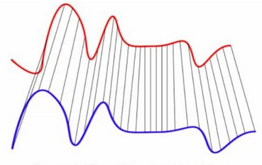
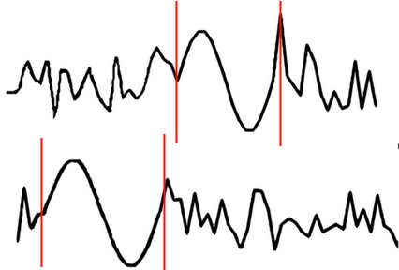
Time Series Classification
Utilise time-based information to improve accuracy
Different approaches available
Distance based
Shape based
Feature based (data trends, means, outliers)
Sub-series based
Filter(convolution) based
Hybrid approaches

Slide 5
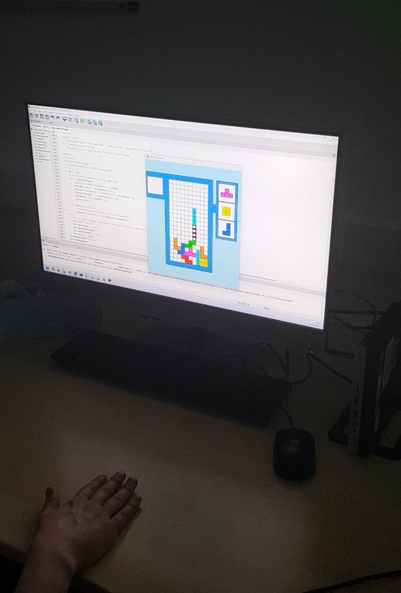

Advantages
High accuracy
Robust for small or noisy data
More potential for interpretability
Fast allowing for real time classification
Implemented in the Python Aeon Toolkit

Slide 6
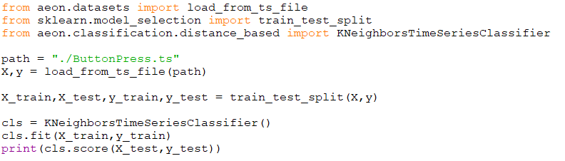
Brain Computer Interfacing Example
EEG Dataset with 32 channels
2 class classification problem
Pressing a button and idle
70% accuracy

Slide 7
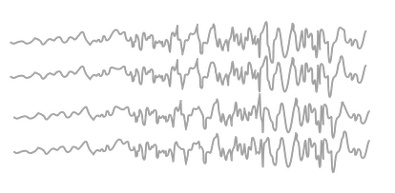
Why It Matters in Clinical Practice
Assistance with detection and diagnosis
Earlier detection
Larger amounts of data to be used
Real time alerts
Improved understanding of medical signals

